Slide 1
COVID-19 DETECTION WITH CHEST X-RAY DATASET USING CNN
PROJECT BY:
SAI MOHITH CHINNARI (1604-18-735-086)
DARAPANENI ANUTHAM SIVA krishNA(1604-18-735-083)
PAPULWAR OM DATHATREYA (1604-18-735-085)
UNDER THE GUIDANCE OF:
MRS.KAMALA KUMARI
Assistant Professor, ECED
MJCET, Hyderabad

Slide 2
Overview
introduction and application areas of convolutional neural networks.
current methods being used to detect covid and how other methods can be used to improve diagnosis.
the definition of cnn, its advantages and the various steps involved in cnn.
methodology
block diagram and its explanation
PROJECT TIME LINE DIAGRAM
REFERENCES

Slide 3
Introduction
The coronavirus pandemic that has spread across the world has placed all sectors on lockdown for many months. Many different approaches have been taken towards detecting Covid-19.
On such method is to diagnose covid-19 infections using radiological images such as x-rays.
This project is focused on making a deep learning based system which utilizes cnn to detect covid-19 from xray images
It is capable of learning from imperative experiences with long term states.

Slide 4
Application areas
Early and efficient detection of covid-19
Smart health care systems
Diagnosis of several ailments in the human body
Detection of tumor regions in the lungs
Detection of x-ray bone suppression

Slide 5
LITERATURE SURVEY:
COVID-net: a tailored deep convolutional neural network design for detection of COVID-19 cases from chest x-ray images. (Wang L., Lin Z.Q. and Wong A):
Motivated by the need for faster interpretation of radiography images, a number of artificial intelligence (AI) systems based on deep learning21 have been proposed and results have shown to be quite promising in terms of accuracy in detecting patients infected with COVID-19 via radiography imaging
Detection of coronavirus disease (COVID-19) based on deep features. (Kumar P. and Kumari S).
The support vector machine classifies the corona affected X-ray images from others using the deep feature. The methodology is beneficial for the medical practitioner for diagnosis of coronavirus infected patient
Automated detection of COVID-19 cases using deep neural networks with X-ray images. (Ozturk T, Talo M, Yildirim EA, Baloglu UB, Yildirim O, Acharya UR):
Recent findings obtained using radiology imaging techniques suggest that such images contain salient information about the COVID-19 virus. Application of advanced artificial intelligence (AI) techniques coupled with radiological imaging can be helpful for the accurate detection of this disease, and can also be assistive to overcome the problem of a lack of specialized physicians in remote villages.

Slide 6
Design objective
Curently covid-19 is being detected using rt-pcr tests which take 4 to 6 hrs to get results which take long time compared to the covid-19 rapid spread rate in addition to being inefficient
as a result many infected patients cannot be detected in time and can unknowingly infect others
With the detection of this disease at an early stage, the prevalence of COVID-19 disease will decrease
Detection of covid-19 using x-ray images is an accurate and efficient method for fast diagnosis. this is done by using a deep learning based system which utilizes cnn to detect covid-19 from xray images

Slide 7
convolutional neural network(cnn)
Convolutional neural networks are deep artificial neural networks that are used primarily to classify images, cluster them by similarity (photo search),and perform object recognition within scenes. By use of CNN’s it can identify faces, individuals, any signs, tumors and many other aspects of visual data.
The main advantage of CNN compared to its predecessors is that it automatically detects the important features without any human supervision.
Steps in cnn:
STEP-1:CONVOLUTION
STEP-2:POOLING
STEP-3:FLATTENING
STEP-4:FULL CONNECTION

Slide 8
methodology
simulation used for code execution :
1.Jupyter notebook:The Jupyter Notebook is an open-source web application that allows you to create and share documents that contain live code, equations, visualizations and narrative text. Uses include: data cleaning and transformation, numerical simulation, statistical modeling, data visualization, machine learning, and much more.
Libraries used:
1.numpy: is a Python library used for working with arrays. It also has functions for working in domain of linear algebra, fourier transform,and matrices. It is an extension of numeric and numarray
2.TensorFlow: is a Python library for fast numerical computing created and released by Google. It is a foundation library that can be used to create Deep Learning models directly or by using wrapper libraries that simplify the process built on top of Tensorflow

Slide 9

Block Diagram of cnn:

Slide 10
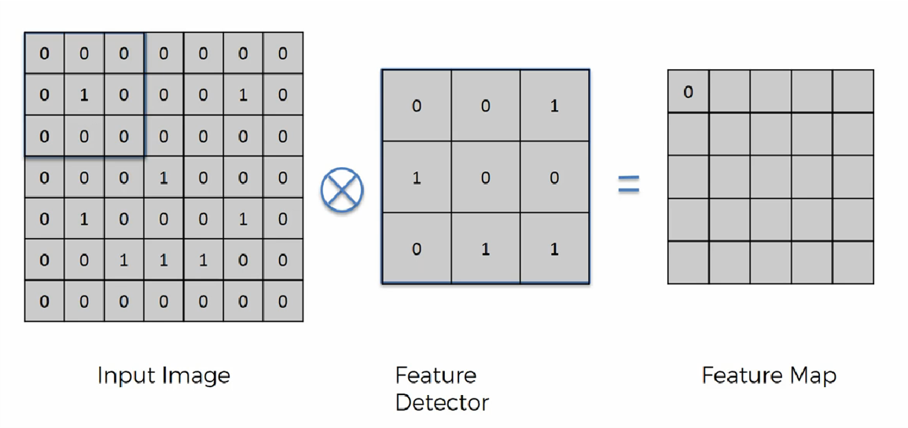
1(A).convolution
The convolution is performed on the input data with the use of a filter or kernel (these terms are used interchangeably) to then produce a feature map.
We execute a convolution by sliding the filter over the input. At every location, a matrix multiplication is performed and sums the result onto the feature map.

Slide 11
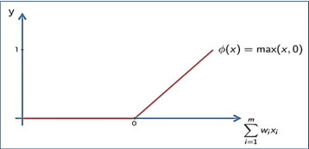
1(B). Rectified Linear Unit(relu)
Appling ReLu Activation function to decrease the linearity in the image, because the image is originally non linear

Slide 12
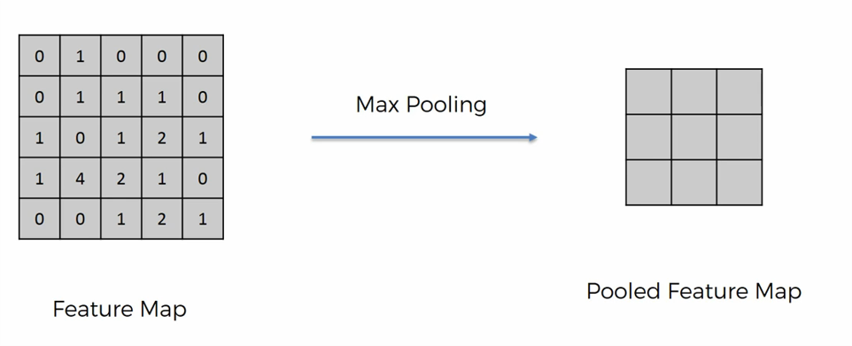
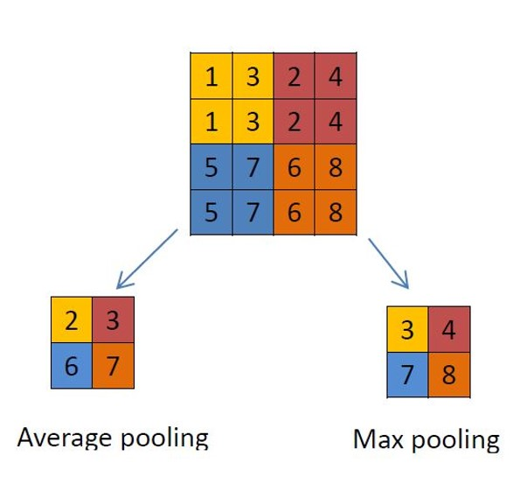
2.pooling
A pooling layer is another building block of a CNN. Its function is to progressively reduce the spatial size of the representation to reduce the amount of parameters and computation in the network. Pooling layer operates on each feature map independently. The most common approach used in pooling is max pooling.

Slide 13
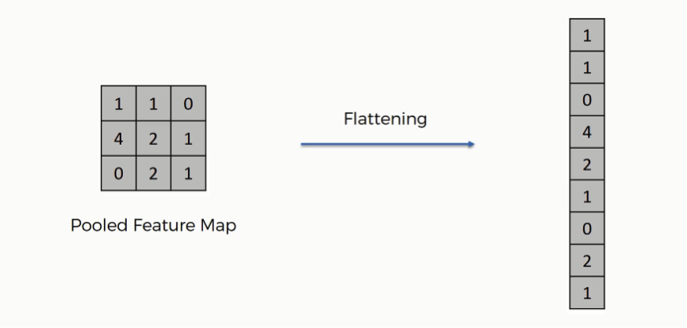
3.flattening
we're supposed to have a pooled feature map by now. As the name of this step implies, we are literally going to flatten our pooled feature map into a column like in the image below.The reason we do this is that we're going to need to insert this data into an artificial neural network

Slide 14
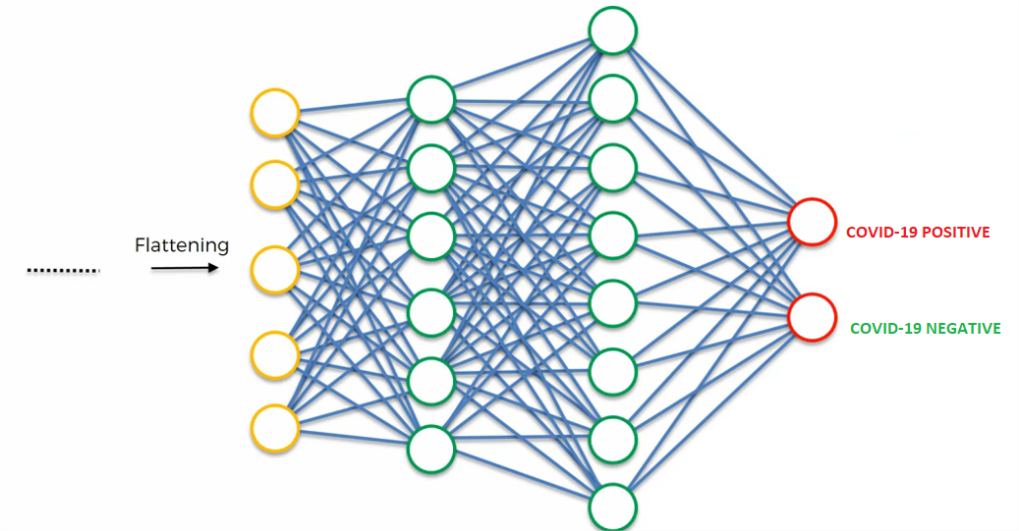
4.Full Connection:
the input layer contains the vector of data that was created in the flattening step. The features that we distilled throughout the previous steps are encoded in this vector. At this point, they are already sufficient for a fair degree of accuracy in recognizing classes. We now want to take it to the next level in terms of complexity and precision.

Slide 15
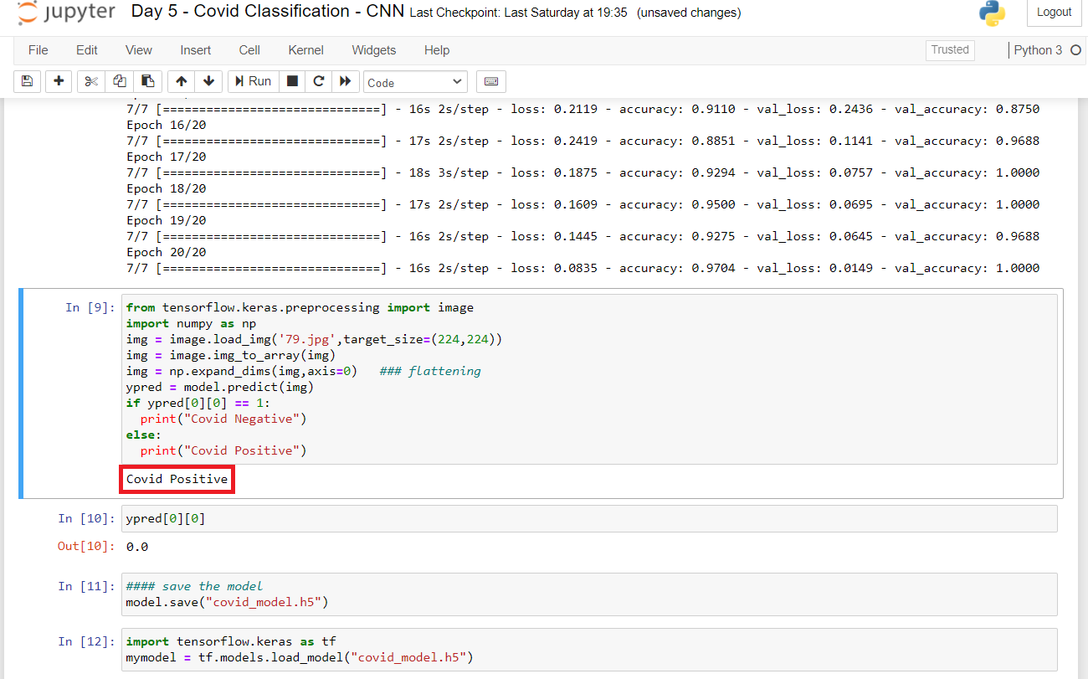
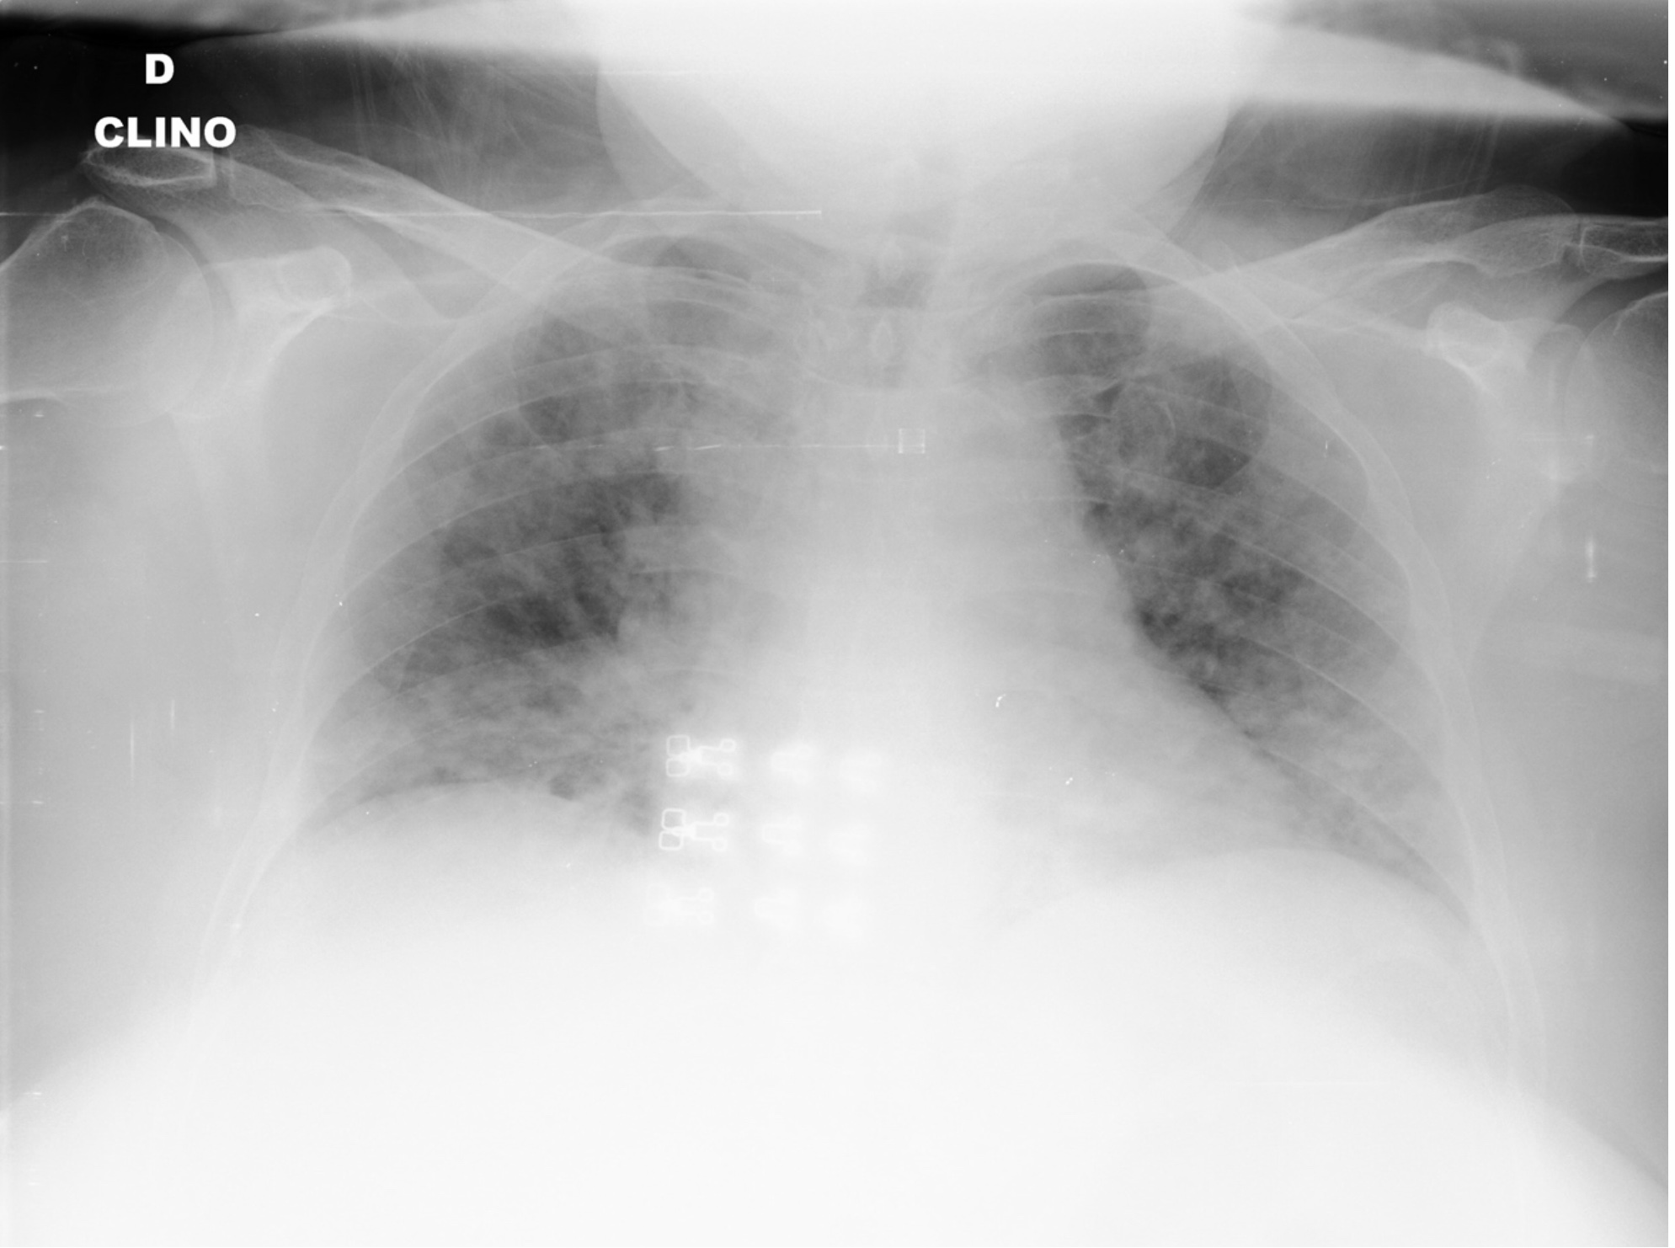
RESULTS:
COVID POSITIVE:

Slide 16
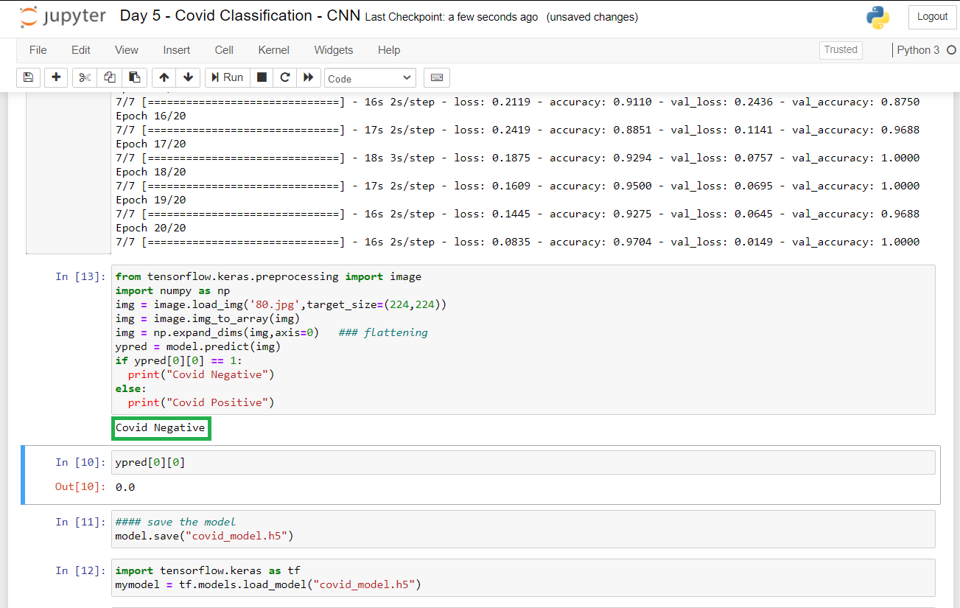
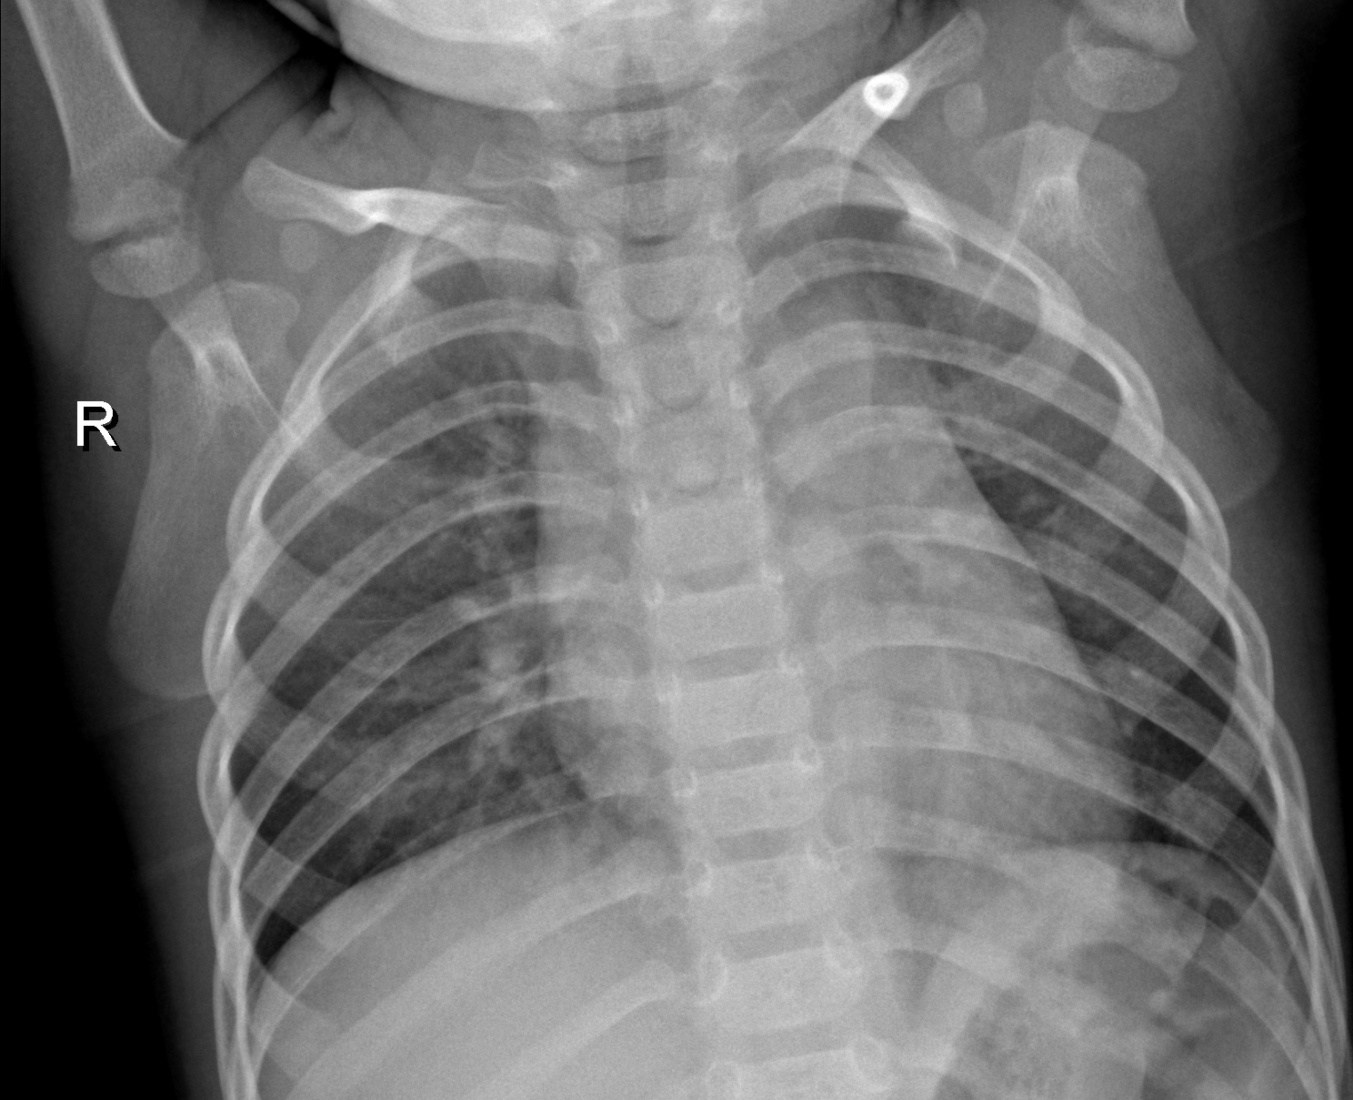
COVID NEGATIVE:

Slide 17
Project time line diagram
S.NO | DATE | PLANNED WORK
1 | 5/02/2021 - 6/02/2021 | TTCIE ABSTRACT SUBMISSION
2 | 15/02/2021 - 20/02/2021 | TTCIE PAPER REVIEW SUBMISSION
3 | 21/02/2021 - 25/02/2021 | MINI PROJECT CODE EXECUTION
4 | 26/02/2021 - 28/02/2021 | PPT FOR MINI PROJECT
5 | 1/03/2021 - 2/03/2021 | PROJECT REPORT
6 | 3/03/2021 | FINISHING TOUCHES

Slide 18
REFERENCES:
https://www.google.com/amp/s/www.freecodecamp.org/news/an-intuitive-guide-to-convolutional-neural-networks-260c2de0a050/amp/
https://www.freecodecamp.org/news/an-intuitive-guide-to-convolutional-neural-networks-260c2de0a050/
https://www.superdatascience.com/blogs/convolutional-neural-networks-cnn-step-4-full-connection
Lauer SA, Grantz KH, Bi Q, Jones FK, Zheng Q, Meredith HR, Azman AS, Reich NG, Lessler J. The incubation period of coronavirus disease 2019 (COVID-19) from publicly reported confirmed cases: estimation and application. Ann Intern Med 2020;2019. https://doi.org/10.7326/M20-0504.
Jibril SIAML, Islam Md M, Sharif US. Predictive data mining models for novel coronavirus (COVID-19) infected patients recovery. SN Comput Sci 2020;1:206. https://doi.org/10.1007/s42979-020-00216-w.
Thevenot J, Lopez MB, Hadid A. A survey on computer vision for assistive medical diagnosis from faces. IEEE J Biomed Health Inf 2018;22:1497–511. https://doi. org/10.1109/JBHI.2017.2754861.

